Slide 1
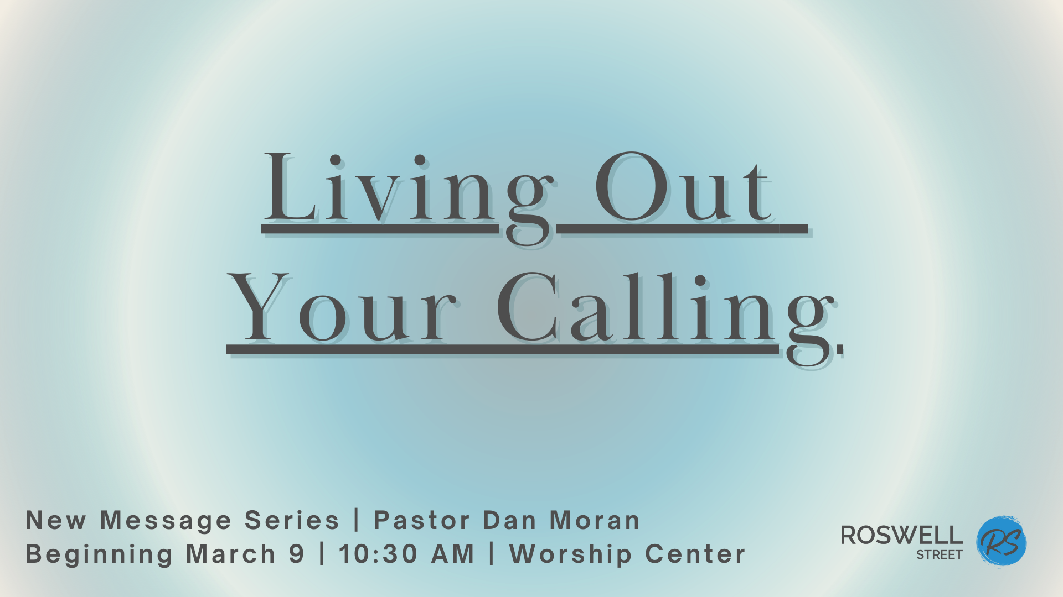

Slide 2
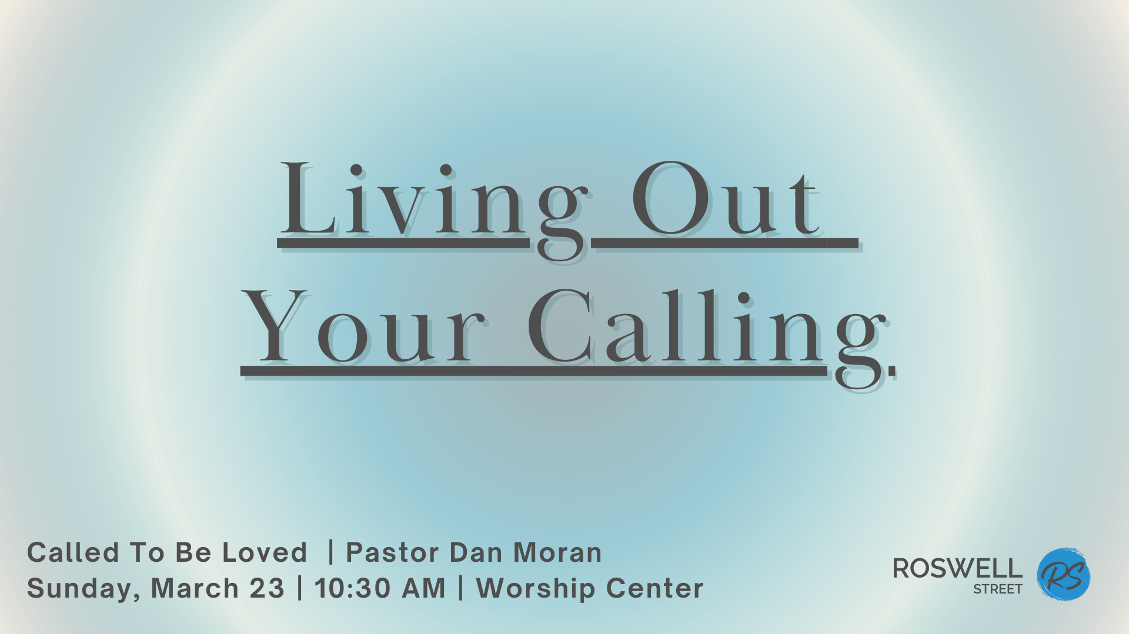

Slide 3


Slide 4
“Long ago, even before he made the world, God loved us and chose us in Christ to be holy and without fault in his eyes. His unchanging plan has always been to adopt us into his own family by bringing us to himself through Jesus
Ephesians 1:4-5 NLT

Slide 5
Christ. And this gave him great pleasure.
Ephesians 1:4-5 NLT

Slide 7
The first purpose of my life is to be
loved by God.

Slide 8
¹ “This letter is from Jude, a servant of Jesus Christ and a brother of James. I am writing to all who are CALLED TO LIVE IN THE LOVE OF GOD the Father and in the CARE of Jesus Christ.”
Jude 1:1 NLT

Slide 10
The first purpose of my life is to be
loved by God.

Slide 11
The first purpose of my life is to be
loved by God.
My first calling is to enjoy a relationship
with God.

Slide 12
⁷ “I am writing to all of you in Rome who are loved by God and are called to be his own holy people. May God our Father and the Lord Jesus Christ give you grace and peace.”
Romans 1:7 NLT

Slide 14
The first purpose of my life is to be
loved by God.

Slide 15
The first purpose of my life is to be
loved by God.
My first calling is to enjoy a relationship
with God.

Slide 16
The first purpose of my life is to be
loved by God.
My first calling is to enjoy a relationship
with God.
The relationship is to be simply His
son or His daughter.

Slide 17
¹ “What an incredible quality of love the Father has shown to us, that we should be named and called and counted the children of God! And so we are!”
1 John 3:1 AMP

Slide 19
“Then Christ will make his home in your hearts as you trust in him. Your roots will grow down into God’s love and keep you strong. 18. And may you have the power to understand, as all God’s people should, how wide, how long,
Ephesians 3:17-19 NLT

Slide 20
how high, and how deep his love is. 19. May you experience the love of Christ, though it is too great to understand fully. Then you will be made complete with all the fullness of life and power that comes from God.”
Ephesians 3:17-19 NLT

Slide 22
What happens if I stay aware of God’s
constant love for me…

Slide 23
What happens if I stay aware of God’s
constant love for me…
  I feel accepted rather than ashamed.

Slide 24
¹ “By faith we have been made acceptable to God. And now, because of our Lord Jesus Christ, we live at peace with God.”
Romans 5:1 CEV

Slide 26
“If God says his chosen ones are acceptable to him, can anyone bring charges against them? Or can anyone condemn them? No indeed!”
Romans 8:33-34 CEV

Slide 28
What happens if I stay aware of God’s
constant love for me…
  I feel accepted rather than ashamed.

Slide 29
What happens if I stay aware of God’s
constant love for me…
  I feel accepted rather than ashamed.
  I am bold in bringing needs to God.

Slide 30
“All who are led by the Spirit of God are children of God! So, you should not be like cowering, fearful slaves. You should behave instead like God’s very own children, adopted into his family – calling him ‘Father, dear Father.’ …
Romans 8:14-15,17 NLT

Slide 31
And since we are his children, we will share his treasures – for everything God gives to his Son, Christ, is ours, too.”
Romans 8:14-15,17 NLT

Slide 33
¹⁶ “Let us then approach the throne of grace with confidence, so that we may receive mercy and find grace to help us in our time of need.”
Hebrews 4:16 NIV

Slide 35
What happens if I stay aware of God’s
constant love for me…
  I feel accepted rather than ashamed.

Slide 36
What happens if I stay aware of God’s
constant love for me…
  I feel accepted rather than ashamed.
  I am bold in bringing needs to God.

Slide 37
What happens if I stay aware of God’s
constant love for me…
  I feel accepted rather than ashamed.
  I am bold in bringing needs to God.
  I have peace in pain I don’t understand.

Slide 38
⁸ “And we know that for those who love God all things work together for good, for those who are called according to his purpose.”
Romans 8:28 ESV

Slide 40
Christians have the exact same problems
the non-Christians do.

Slide 42
What happens if I stay aware of God’s
constant love for me…
  I feel accepted rather than ashamed.

Slide 43
What happens if I stay aware of God’s
constant love for me…
  I feel accepted rather than ashamed.
  I am bold in bringing needs to God.

Slide 44
What happens if I stay aware of God’s
constant love for me…
  I feel accepted rather than ashamed.
  I am bold in bringing needs to God.
  I have peace in pain I don’t understand.

Slide 45
What happens if I stay aware of God’s
constant love for me…
  I feel accepted rather than ashamed.
  I am bold in bringing needs to God.
  I have peace in pain I don’t understand.
  I gain the courage to take risks.

Slide 46
¹⁸ “There is no fear in love. But perfect love drives out fear, because fear has to do with punishment.”
1 John 4:18 NIV

Slide 48
What happens if I stay aware of God’s
constant love for me…
  I feel accepted rather than ashamed.

Slide 49
What happens if I stay aware of God’s
constant love for me…
  I feel accepted rather than ashamed.
  I am bold in bringing needs to God.

Slide 50
What happens if I stay aware of God’s
constant love for me…
  I feel accepted rather than ashamed.
  I am bold in bringing needs to God.
  I have peace in pain I don’t understand.

Slide 51
What happens if I stay aware of God’s
constant love for me…
  I feel accepted rather than ashamed.
  I am bold in bringing needs to God.
  I have peace in pain I don’t understand.
  I gain the courage to take risks.

Slide 52
What happens if I stay aware of God’s
constant love for me…
  I feel accepted rather than ashamed.
  I am bold in bringing needs to God.
  I have peace in pain I don’t understand.
  I gain the courage to take risks.
  I worship instead of worry.

Slide 53
“So don’t worry about having enough food or drink or clothing. He will give you all you need from day today if you live for him and make the Kingdom of God your primary concern. So don’t worry about tomorrow, for tomorrow
Matthew 6:31-34 NLT

Slide 54
will bring its own worries. Today’s trouble is enough for today.”
Matthew 6:31-34 NLT

Slide 56
Worship and worry cannot reside in the
same heart.

Slide 58
¹³ “Give yourselves completely to God since you have been given new life.”
Romans 5:13b NLT

Slide 60
¹² “To all who believed him and accepted him, Jesus gave the right to become children of God.”
John 1:12 NLT

